Slide 1
Decidable Problems of
Regular Languages

Slide 2



Membership Question
Question:
Given regular language
and string
how can we check if ?
Answer:
Take the DFA that accepts
and check if is accepted

Slide 3


DFA
DFA

Slide 4
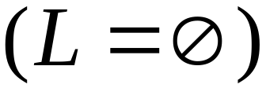
Question:
Given regular language
how can we check
if is empty: ?
Answer:
Take the DFA that accepts
Check if there is any path from
the initial state to an accepting state

Slide 5


DFA
DFA

Slide 6
Question:
Given regular language
how can we check
if is finite?
Answer:
Take the DFA that accepts
Check if there is a walk with cycle
from the initial state to a final state

Slide 7
DFA
is infinite
DFA
is finite

Slide 8


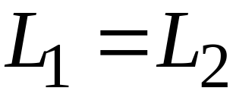
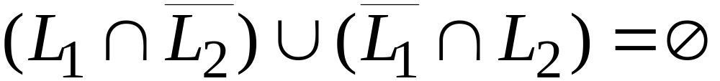
Question:
Given regular languages and
how can we check if ?
Answer:
Find if

Slide 9
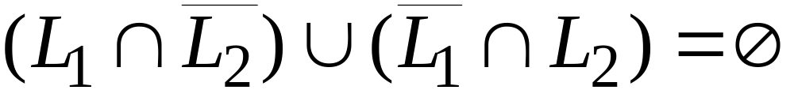
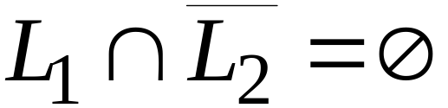
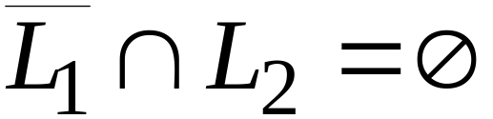


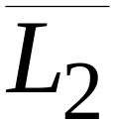
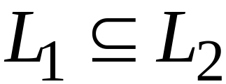
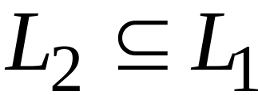
and

Slide 10
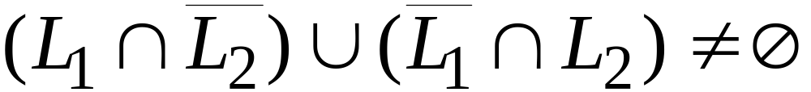
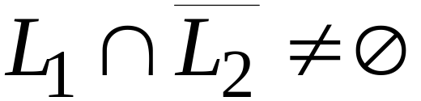
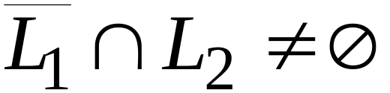
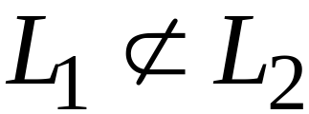
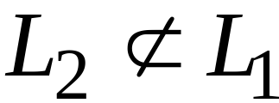
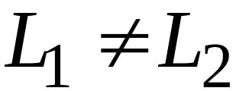
or

Slide 11
Decidable Problems of
Context-Free Languages

Slide 12


Membership Question:
for context-free grammar
find if string
Membership Algorithms:
Parsers
Exhaustive search parser
CYK parsing algorithm

Slide 13
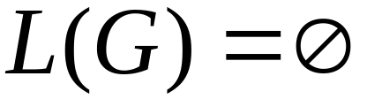

Empty Language Question:
for context-free grammar
find if
Algorithm:
Remove useless variables
Check if start variable is useless

Slide 14
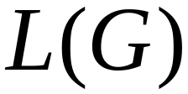

Infinite Language Question:
for context-free grammar
find if is infinite
Algorithm:
1. Remove useless variables
2. Remove unit and productions
3. Create dependency graph for variables
4. If there is a loop in the dependency graph
then the language is infinite

Slide 15
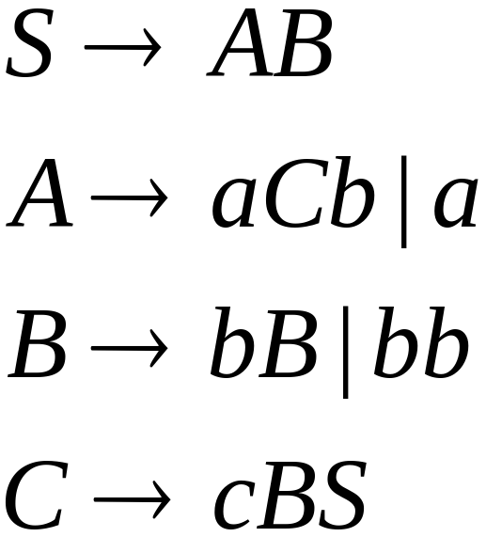




Example:
Infinite language
Dependency graph

Slide 16
